Slide 1
Individual and Family Plans Quoting & Enrollment
Broker Training
2021
10142021

Slide 2
Training Topics
01 — Getting Started
02 — Checking Eligibility
03 — Off Exchange
04 — On Exchange (Marketplace)

Slide 3
Getting Started

Slide 4
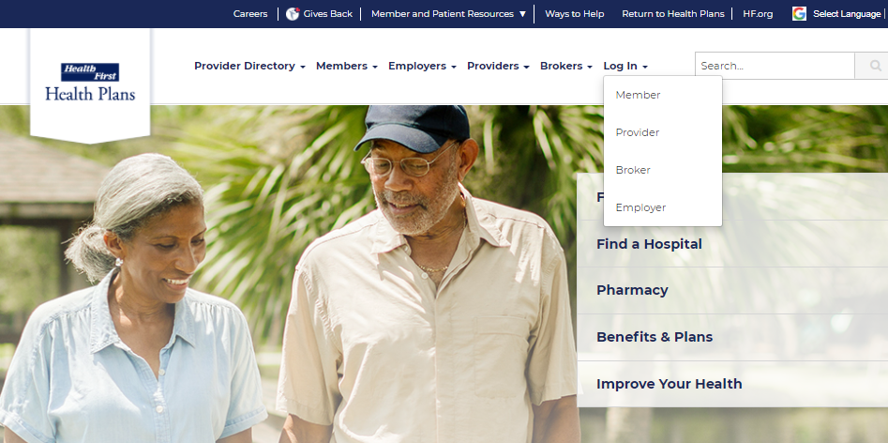
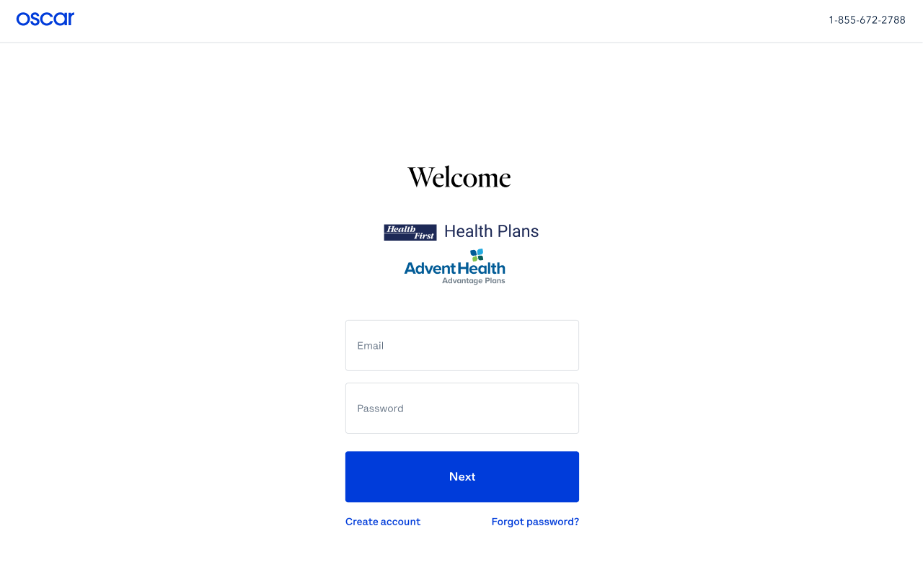
Getting Started – Log In
From the public website, locate the Broker Portal login page:
1. myHFHP.org or myAHPlan.com
2. Click “Login”
3. Click “Broker”
4. Log in
Note: Google Chrome is recommended

Slide 5
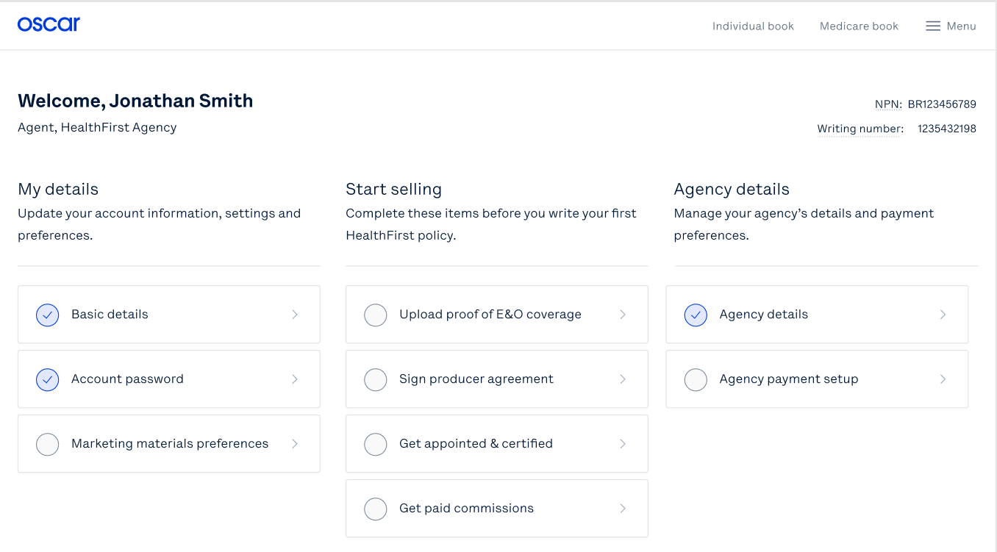
Locating your BoB
To begin, select Individual book via the top navigation bar of the broker portal
Then, select “Enroll new policy”
Agent, Health First Agency
Complete these items before you write your first Health First policy.
Note: Historical data (2021 plan information) will not be populated in the Broker Portal. Member payment information will need reestablished.

Slide 6
Checking Eligibility
Notes:
Now once you have selected to enroll a new policy, we need to make sure the MM is eligible to enroll

Slide 7
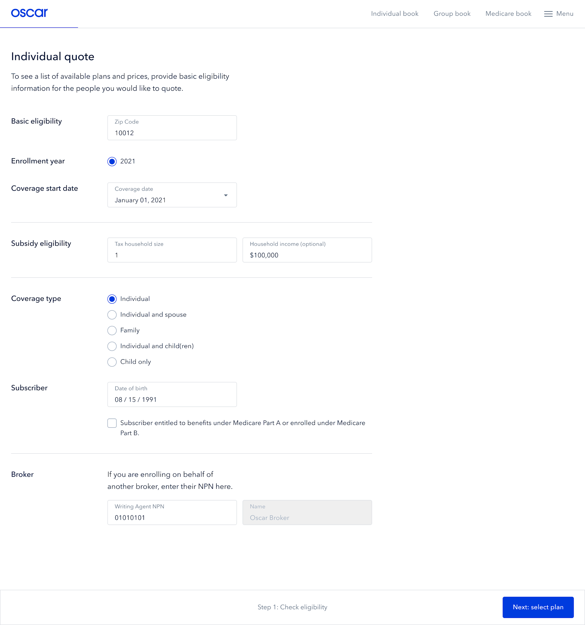
Enrolling: Check Eligibility
Enter the potential member’s zip code
Select the correct enrollment year (ex. 2022)
Select coverage start date (ex. January 1, 2022)
Enter subsidy eligibility information (household size, and income)
Select coverage type
Enter potential member’s date of birth
Confirm broker information (ex. NPN) - this should auto populate
Select “Next: select plan”
2022
January 1 2022
Notes:
Walk through step 1-8, adv now there are 2 options for MM’s to enroll either ON or OFF ex. Lets take a look at OFF exchange first

Slide 8
Off Exchange

Slide 9
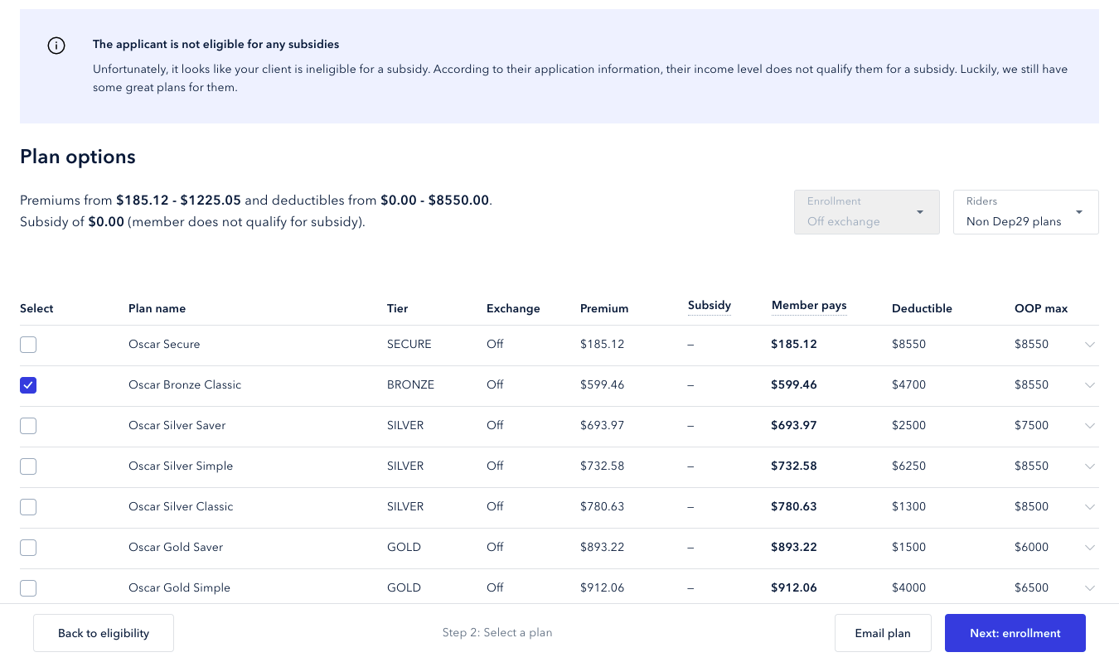
Enrolling: Off Exchange
Review plan options.
Click the down arrow next to each plan to review additional plan details
Select a plan
3. Select “Next: enrollment”
AdventHealth GYM ACCESS Bronze HMO
BRONZE
AdventHealth GYM ACCESS Bronze HMO
Health First Silver HMO
Health First Silver HMO
Health First Silver HMO
Health First GYM ACCESS Gold HMO
Health First GYM ACCESS Gold HMO
For demonstration purposes ONLY, sample plan data is shown above

Slide 10
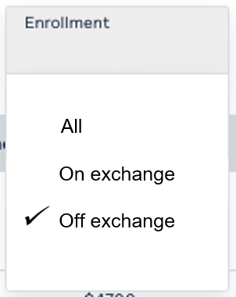
Enrolling: Off Exchange
Note: You can use the toggle to switch between On Exchange, Off Exchange, or All Plans if the member is eligible
For demonstration purposes ONLY, sample plan data is shown above

Slide 11
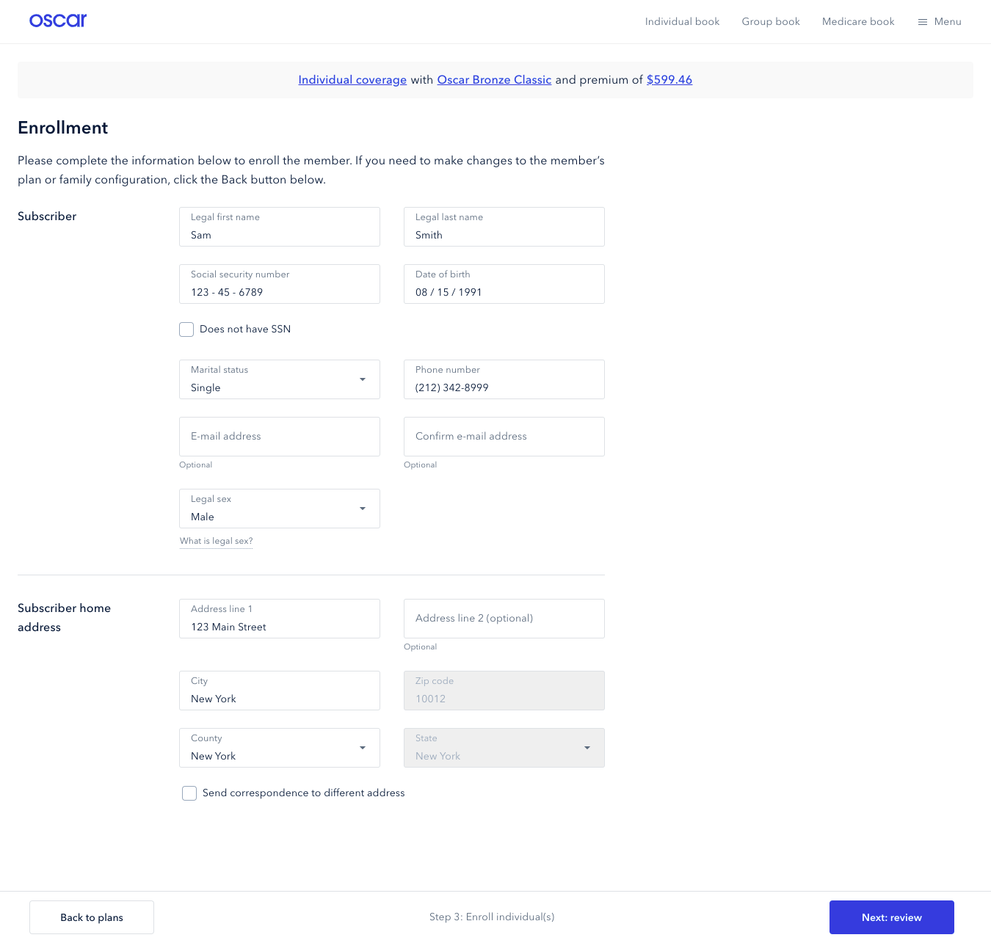
Enrolling: Off Exchange
Individual coverage with Health First Silver HMO and a premium of $599.46
4. Complete the subscriber information
5. Select “Next review”
For demonstration purposes ONLY, sample plan data is shown above

Slide 12
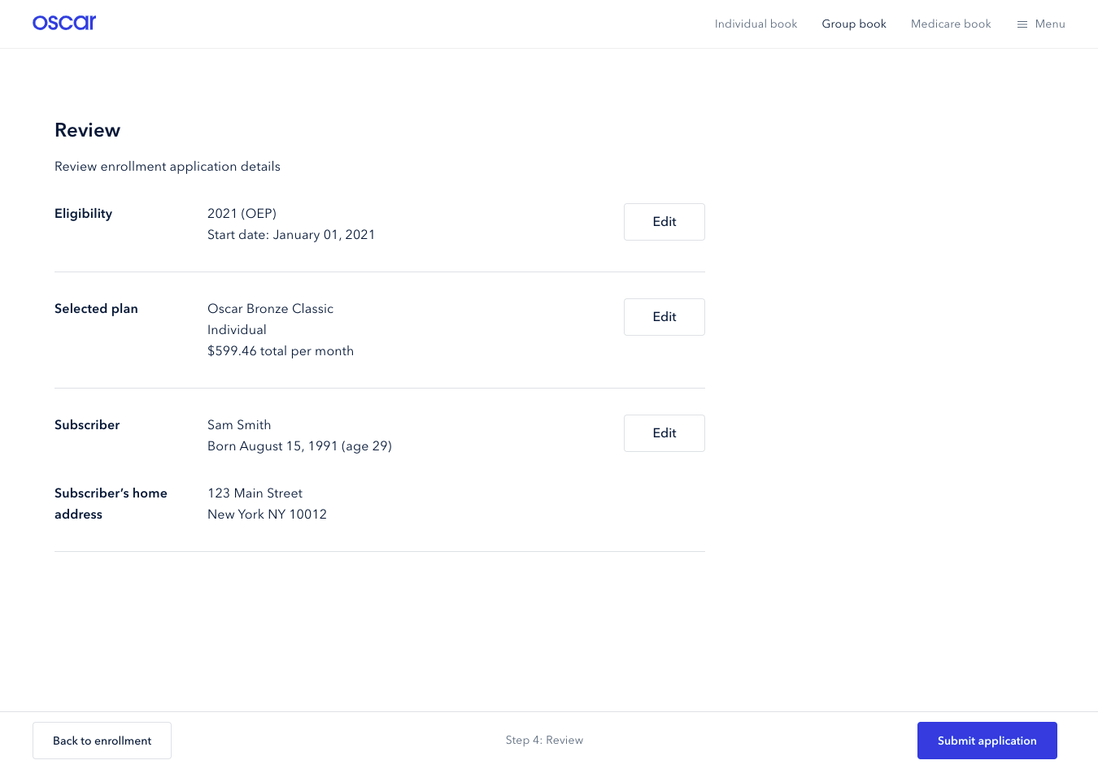
Enrolling: Off Exchange
6. Review the following:
Eligibility
Selected plan
Subscriber
Subscriber’s home address
7. Select “Submit application”
2022 (OEP)
Start date: January 01, 2022
Health First Silver HMO
You can edit any details by selecting “Edit” next to each field
For demonstration purposes ONLY, sample plan data is shown above

Slide 13
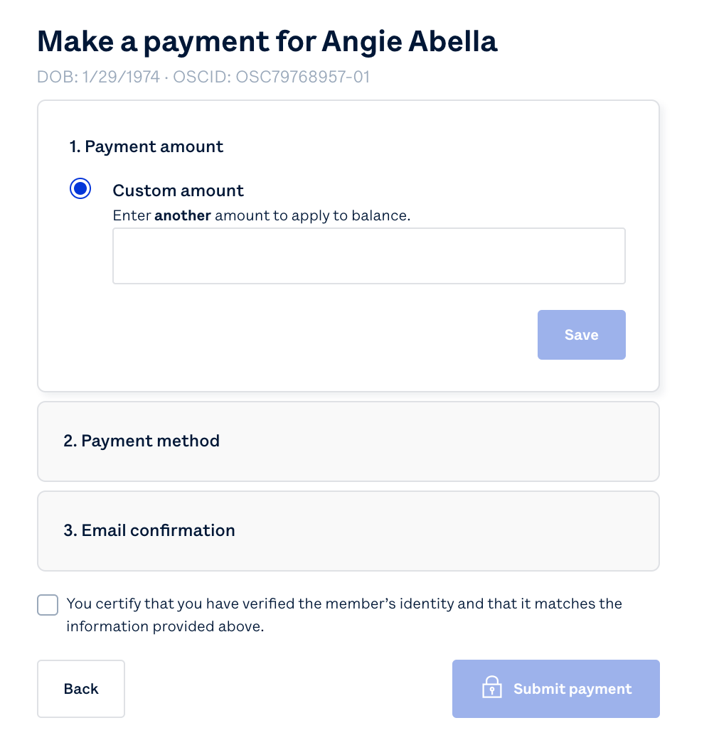
Enrolling: Off Exchange - Member Payment
Make a payment for Barbara Banks
DOB: X/X/XXX OSCID: OSC0000000-00
Applications for off-exchange clients will be processed within 1-3 business days. Brokers will see member details within their BoB within 5-10 business days.
At that time, brokers should navigate to the BoB and search for the appropriate member. Select Make a payment, with the members banking/payment information, then enter the payment amount and method on behalf of your client.
For demonstration purposes ONLY, sample data is shown above

Slide 14
On Exchange

Slide 15
Enrolling: On Exchange
Note: You can use the toggle to switch between On Exchange, Off Exchange, or All Plans if the member is eligible
For demonstration purposes ONLY, sample plan data is shown above

Slide 16
Enrolling: On Exchange
Individual plans with for September 1, 2022 in Florida for a tax household of 1 with income of $30,000
Review plan options.
You can review subsidy estimates here for each plan. These will be confirmed on the exchange.
Select a plan
3. Select “Next: enrollment”
On
On
On
On
On
On
On
For demonstration purposes ONLY, sample plan data is shown above

Slide 17
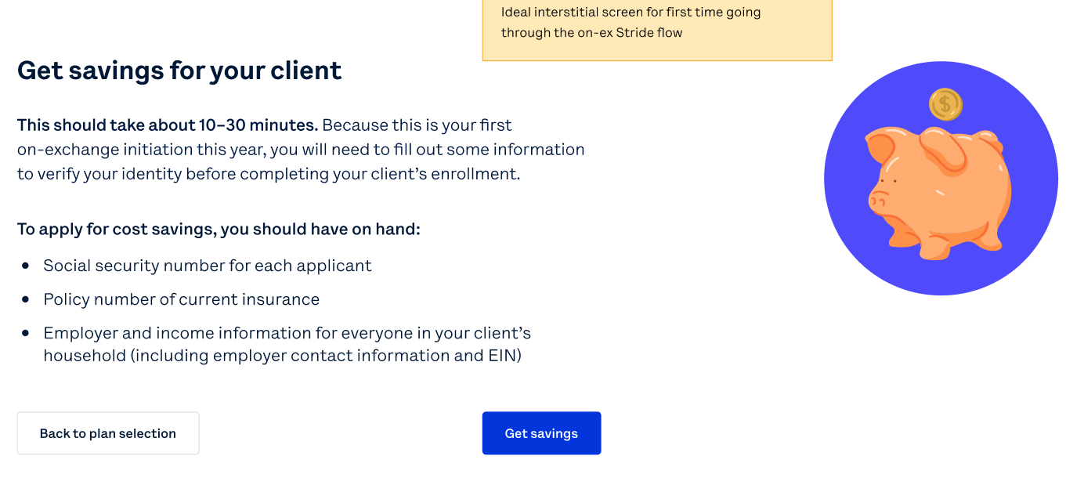
Enrolling: On Exchange – Broker Registration
Select “Get Savings” to complete the On-Exchange enrollment
Note: Broker registration steps will only need to be completed once per selling season

Slide 18
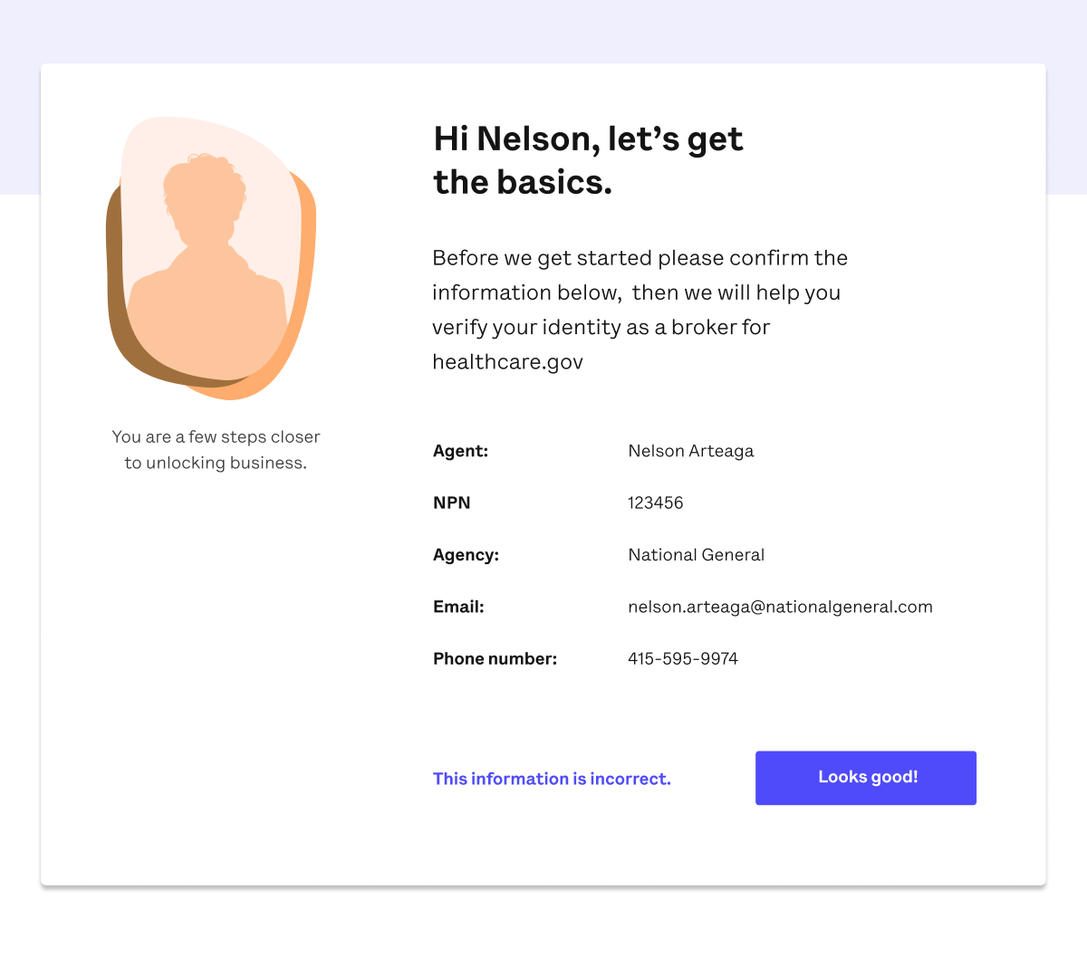
Enrolling: On Exchange – Broker Registration
Review your basic information
Note: Broker registration steps will only need to be completed once per selling season

Slide 19
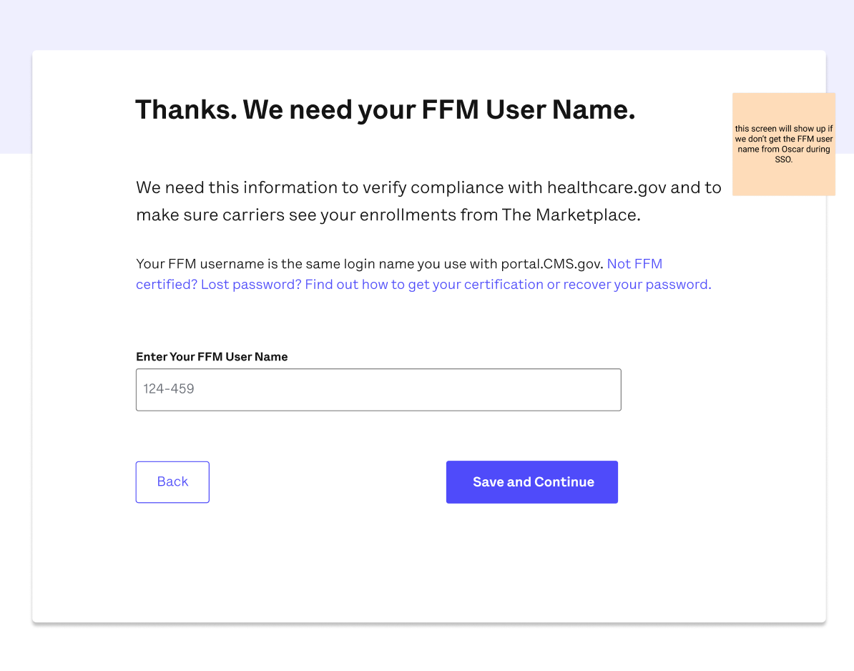
Enrolling: On Exchange – Broker Registration
Enter FFM User Name
You would have created your FFM user ID when you completed FFM registration and training at portal.cms.gov
Note: Broker registration steps will only need to be completed once per selling season

Slide 20
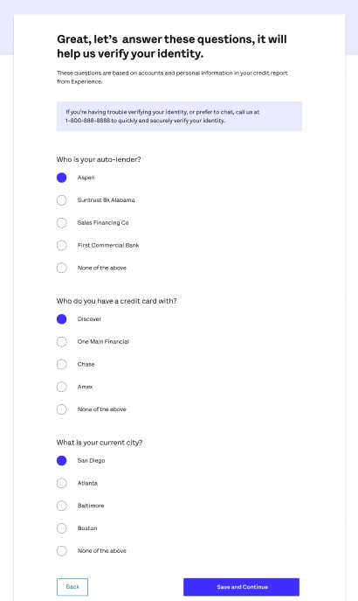
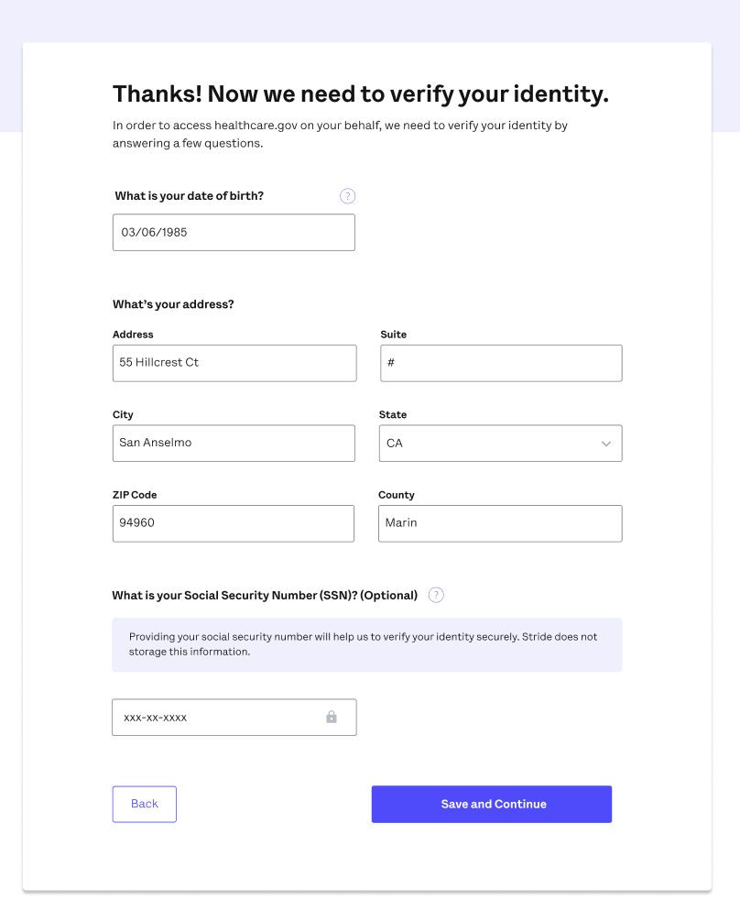
Enrolling: On Exchange – Broker Registration
Verify identity through a series of inputs and questions
Note: Broker registration steps will only need to be completed once per selling season

Slide 21
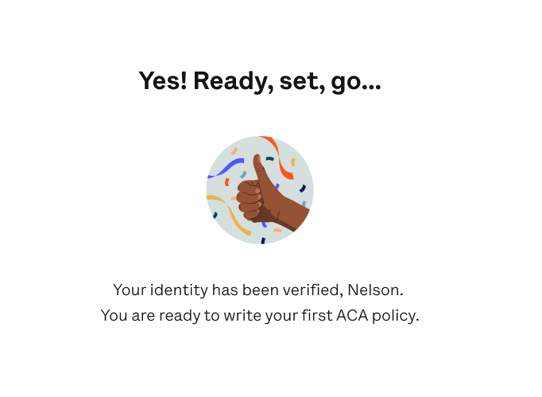
Enrolling: On Exchange – Broker Registration
Once identity verification is complete, the broker can move forward with the enrollment process.
Note: Brokers will only need to complete identity verification ONCE per selling season. After they’ve done this the first time, they will not have to do it again and will move immediately into the enrollment flow.

Slide 22
Enrolling: On Exchange (FFM)
Health First Silver HMO
8. Starting the application
Brokers will attest they have received permission from their client to continue the application and that they have verified their client’s identity

Slide 23
Enrolling: On Exchange (FFM)
If the client has an existing Marketplace application, the broker will be able to select the existing application

Slide 24
Enrolling: On Exchange (FFM)
If the client does not have an existing Marketplace application, there will be an option to start a new application.

Slide 25
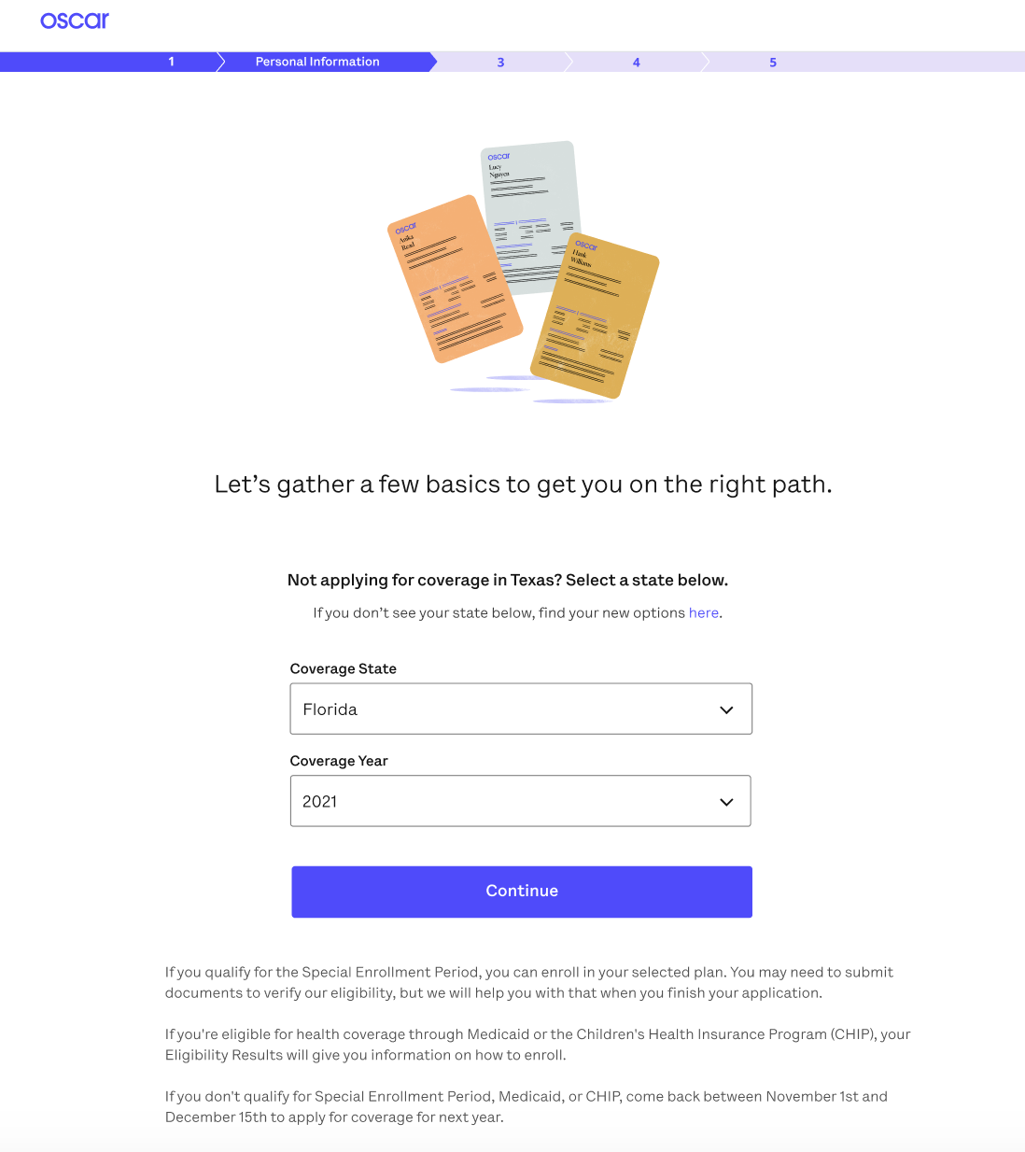
Enrolling: On Exchange (FFM)
9. To continue with the application, select Coverage State & Year

Slide 26
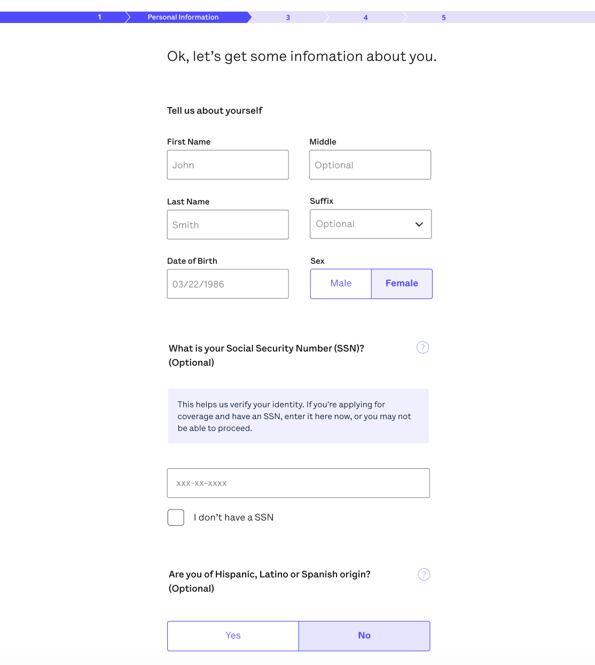
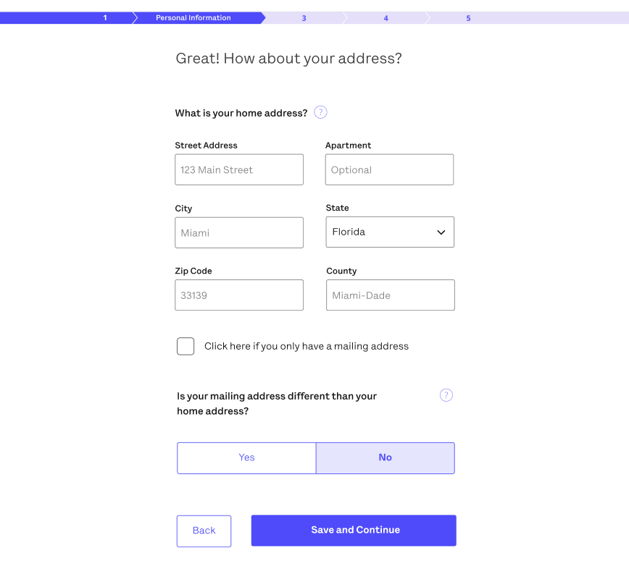
Enrolling: On Exchange (FFM)
10. Enter Member Information
This includes demographic, income, and other eligibility information for all members of household

Slide 27
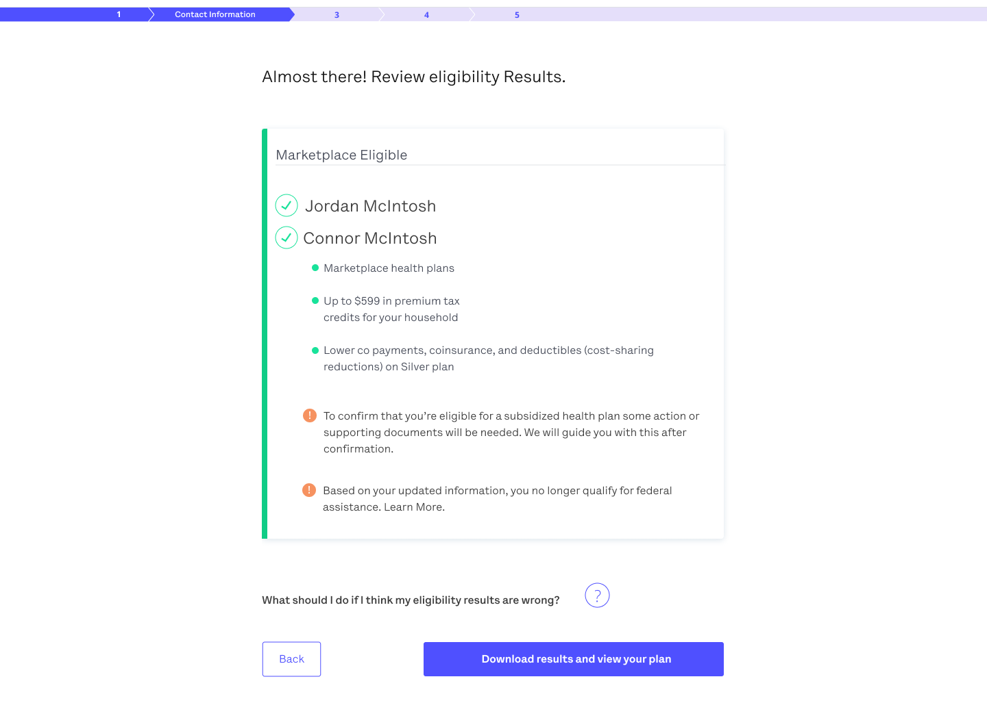
Enrolling: On Exchange (FFM)
11. Download Eligibility Results
Based on the information provided on the application, the Marketplace will determine if the client is eligible to enroll in Marketplace coverage and their eligibility for a subsidy

Slide 28
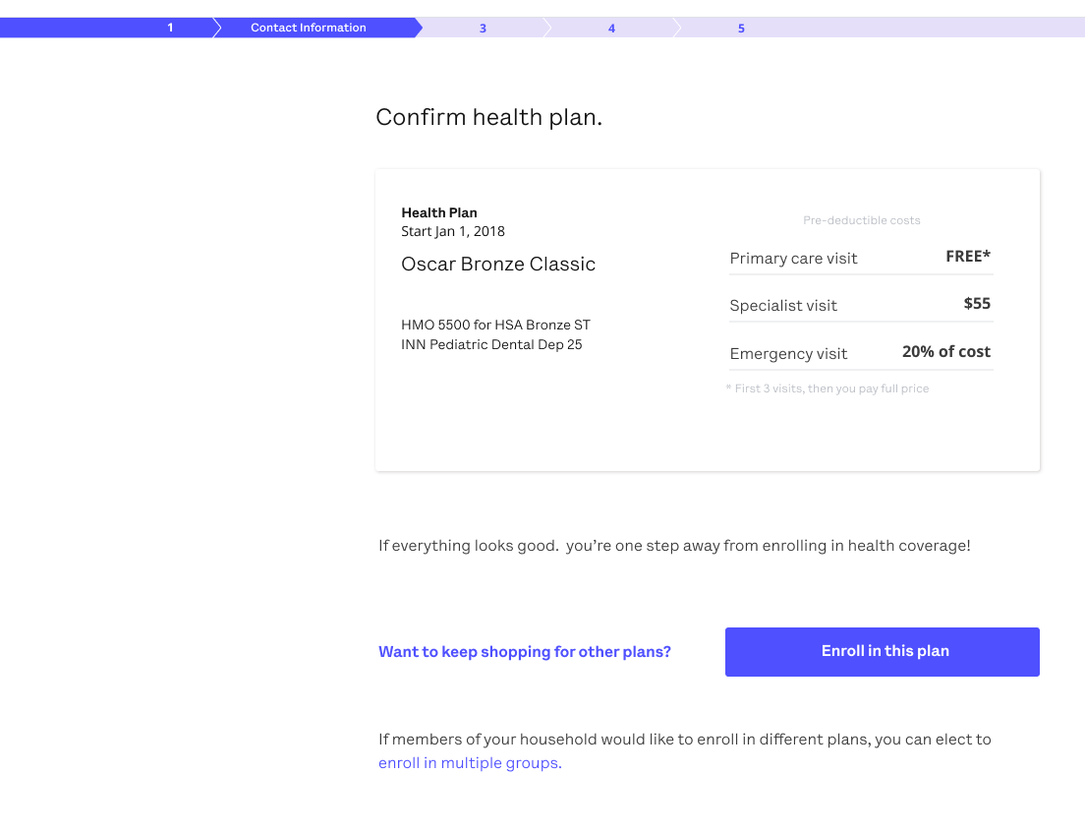
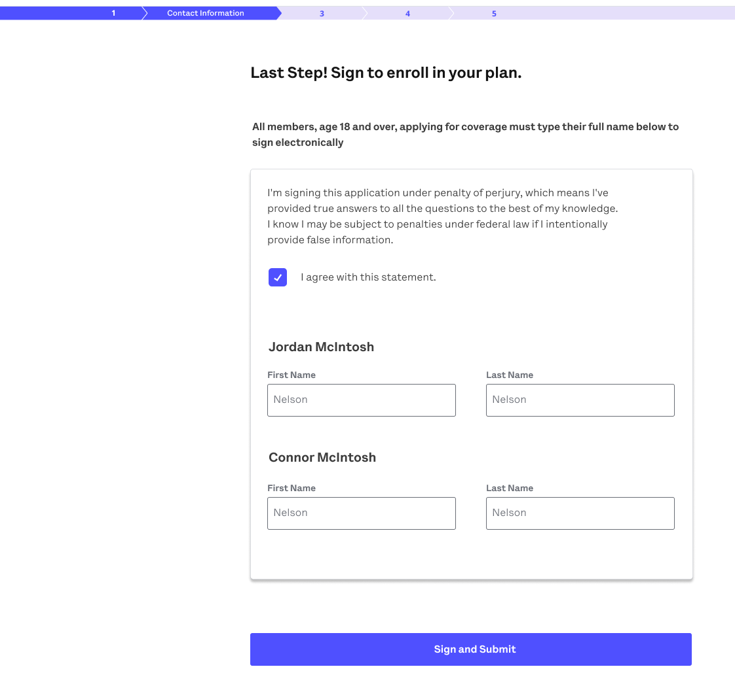
Enrolling: On Exchange (FFM)
Health First Bronze HMO
12. Confirm plan

Slide 29
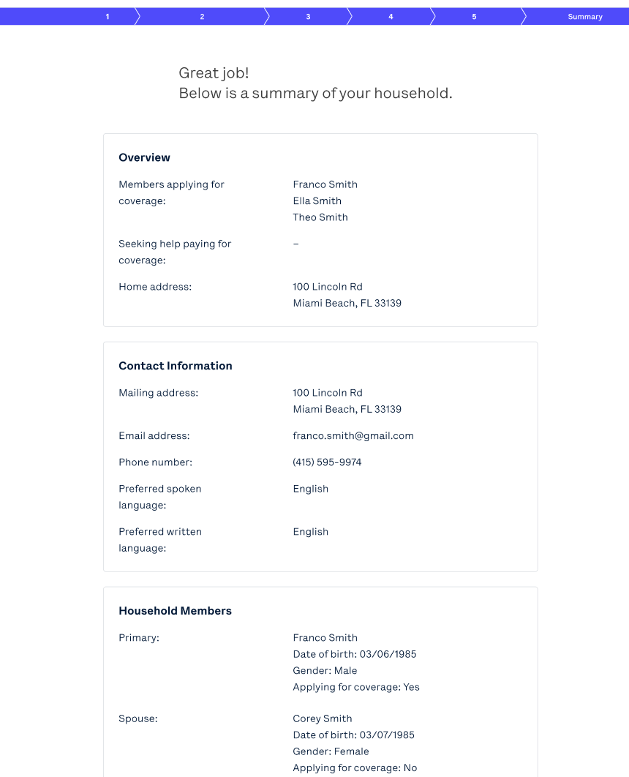
Enrolling: On Exchange (FFM)
Return to Broker Portal
Review information
Once reviewed, click Return to Broker Portal.

Slide 30
Enrolling: On Exchange - Member Payment
Make a payment for Barbara Banks
DOB: X/X/XXX OSCID: OSC0000000-00
Brokers will see member details within their BoB after the application has been fully processed.
At that time, brokers should navigate to the BoB and search for the appropriate member. Select Make a payment, with the members banking/payment information, then enter the payment amount and method on behalf of your client
For demonstration purposes ONLY, sample data is shown above

Slide 31
Post Enrollment

Slide 32
Next Steps
Brokers will receive a confirmation email
Applications for off-exchange clients will be processed within 1-3 business days
Applications for on-exchange clients will be processed within 7-10 business days
Brokers will see member details in their BoB within 3-10 business days
Members will receive their Welcome Kit 10 business days after their enrollment is accepted
Members will be able to access their Digital ID Card 24 hours post effectuation from their member portal

Slide 33
Oscar’s Broker Support Team is here to help
✓ Broker account support
✓ Appointment & certification support
✓ Commissions escalations
✓ Eligibility inquiries
✓ Member inquiries & support
✓ Network/Rx support
Monday through Friday 8:00am - 6:00pm EST
hf-brokers@plusoscar.com
hf-brokercommissions@plusoscar.com
877-693-6489

Slide 34
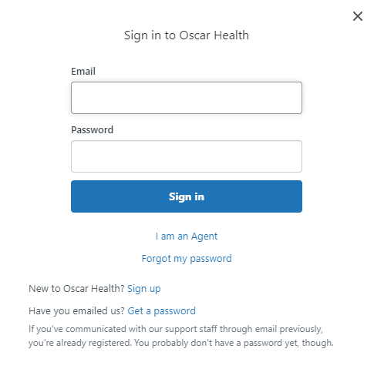
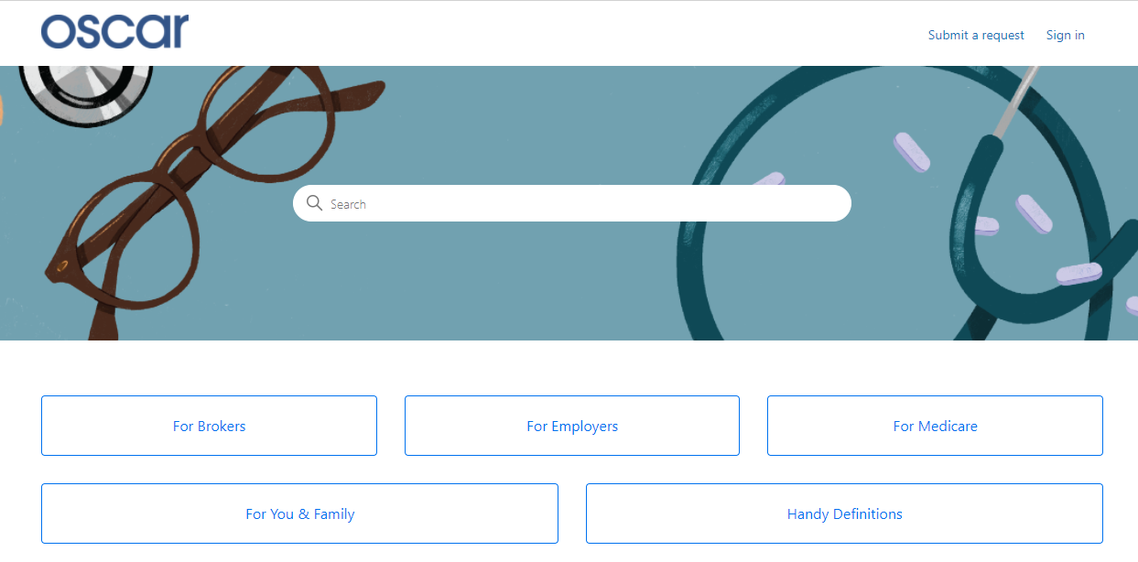
Creating Your Zendesk Account
In order for brokers to communicate with Oscar through the designated emails provided, you will need to create an account through Zendesk. Follow the below steps.
Start at Oscar’s Zendesk Help Center
Click "Sign in" from the top right
A pop-up window will prompt you to sign in. If you don’t have an account, select "Sign up" next to "New to Oscar Health?"
Submit your full name and email address
Click the blue "Sign up" button. Look for an email to complete account set-up.
From your inbox, look for "Welcome to Oscar Health." Click the link to complete creating your password.
You can now successfully communicate to/from, via email, with Oscar.

Slide 35
Health First Health Plans Broker Services is available: Monday through Friday 8:00 a.m. to 5:00 p.m.
For questions contact us at: 321.434.5265 or HFBroker@HF.org

